Slide 1
Team 05-RiversideRouting
Sai Vamsi Reddy Kinkiri
Devaki Kalyan Chandra Yadav Podia
Venkata Hemanth Paladugu
Harsha Vardhan Reddy Devarapalli
Sri Sai Naga Venkata Adithya Swarna

Slide 2
Problem Statement
BGP is essential for Internet data routing but its vulnerabilities can lead to data loss or delays, impacting global web services.
Analyzing BGP's operational dynamics is increasingly complex due to the vast amount of update traffic and the Internet's growing scale.
Identifying root causes of BGP issues is challenging, requiring access to core network data across domains, highlighting the need for targeted analysis of significant network events.

Slide 3
Contribution
We collected and analyzed BGP data to uncover insights into the stability and dynamics of internet routing.
This project focuses on classifying BGP updates into key categories to deepen our understanding of Internet routing dynamics and pinpointing patterns that signal network health.
By analyzing these classifications and specific patterns, alongside key statistical measures, we aim to uncover insights into routing stability and efficiency, guiding improvements in Internet infrastructure.

Slide 4
Motivation
Unravel BGP complexities and vulnerabilities to improve Internet routing stability and security.
Analyze extensive BGP data for deeper insights into global connectivity disruptions, inspired by events like the 2021 Meta outage.
Enhance digital infrastructure resilience by diagnosing and mitigating BGP risks, ensuring reliable global Internet connectivity.

Slide 5
Roadmap

Slide 6
Background
BGP guides Internet data but can fail, leading to disruptions; previous studies often overlooked its complexities.
This project analyzes extensive BGP data to identify anomalies, employing advanced techniques and real-life event testing.
It combines signature and statistics-based detection with visualization to accurately pinpoint and address routing failures.

Slide 7
Model
Devised an approach that systematically gathers and examines BGP routing information to illuminate the dynamics and stability of Internet paths, offering novel insights into the behavior of digital networks over time.
Our model classifies BGP updates into UP, DOWN, WITHDRAWAL, and FLAT categories, utilizing a Python script to automate the process based on changes in route preferences like AS_PATH length and ORIGIN type.
By identifying specific BGP update patterns (Types B, C, and F) and implementing statistical measures such as Inter-Arrival Time, Number of AS Path Changes, and Average Path Length, we gain insights into the stability, efficiency, and potential anomalies within the routing environment.

Slide 8
Definitions
BGP Update Classification
UP: More favorable route updates, improving data packet paths.
DOWN: Less favorable updates, indicating decreased routing efficiency.
WITHDRAWAL: Route withdrawals signaling routing disruptions.
FLAT: Unchanged routing updates, marking network stability.
Pattern Identification (B, C, F)
Type B (Burst): WITHDRAWAL followed by quick route reintroduction — transient failures & fast recovery.
Type C (Change): Single movement UP or DOWN — temporary route preference fluctuations.
Type F (Flat): Continuous unaltered updates — stable conditions or areas for concern.

Slide 9
Innovation/Contribution - Part 1
Developed a custom Python script for parsing IP addresses from a JSON file and fetching BGP updates from the RIPE Stat API for each IP.
Automatically saves BGP updates into individual JSON files named after each entity, streamlining the data collection process.
The analysis phase reads these JSON files, extracting essential data like timestamps and BGP path attributes to understand routing dynamics.
Calculates critical metrics, including distinct path counts and prefix lifetimes, to evaluate path stability and diversity.
Offers a high-level overview of BGP routing dynamics, emphasizing path persistence and the frequency of route changes.

Slide 10
Innovation/Contribution - Part 2
Automated Analysis of BGP Data
Efficiency: Our system automates the analysis of vast datasets, enabling the processing of large volumes of BGP updates without manual intervention.
Accuracy: Utilizes sophisticated algorithms for the precise classification of updates and identification of patterns, ensuring high reliability of insights derived from the data.

Slide 11
Innovation/Contribution - Part 2
Testing Against Network Outages
Practical Relevance: Our methodologies were put to the test with real-world data from significant network outages, including the 2021 Meta outage, validating their effectiveness in practical scenarios.
Insights: The analysis successfully identified and detailed the nature of disruptions, proving the model's capability in real-world conditions.

Slide 12
Innovation/Contribution - Part 2
Making Complex Data Understandable
Intuitive Understanding: We employ graphical representations to depict network states during various operational conditions, making complex BGP dynamics accessible at a glance.
Actionable Insights: These visualizations translate intricate BGP behavior into clear, actionable information for network administrators, aiding in decision-making and network management.

Slide 13
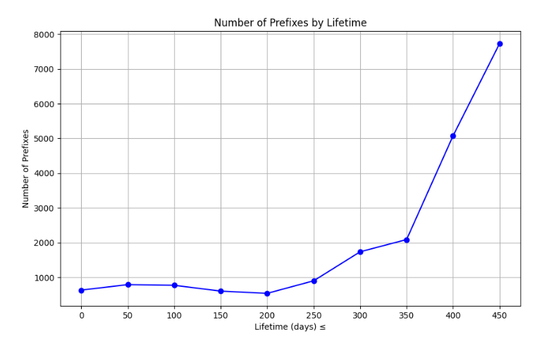
Experimental Results (Part 1)
Analyzed a total of 20,896 prefixes in this study.
Identified 831 prefixes (3.97% of total) with visibility for less than 10 days.
Found that 10,261 prefixes (49.10% of total) had a consistent routing path for at least 50% of their observable lifespan.
Discovered 7,830 prefixes (37.47% of total) used two or fewer distinct routing paths during their visibility period.

Slide 14
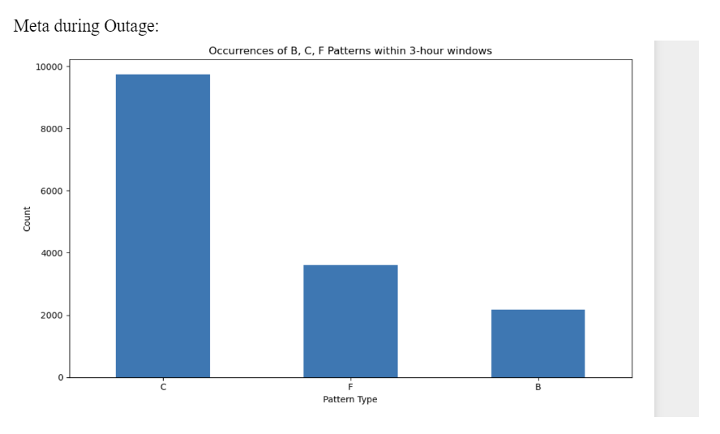
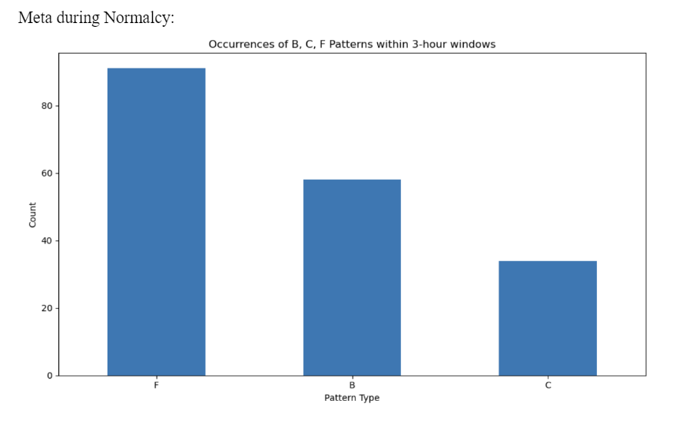
Experimental Results - Meta (B, C, F Occurrences)

Slide 15
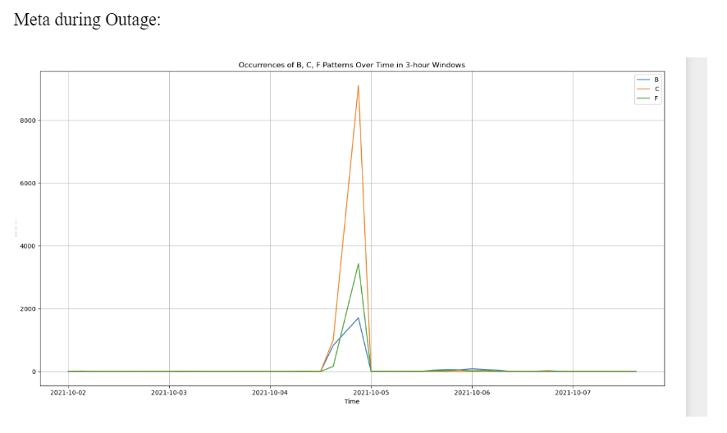
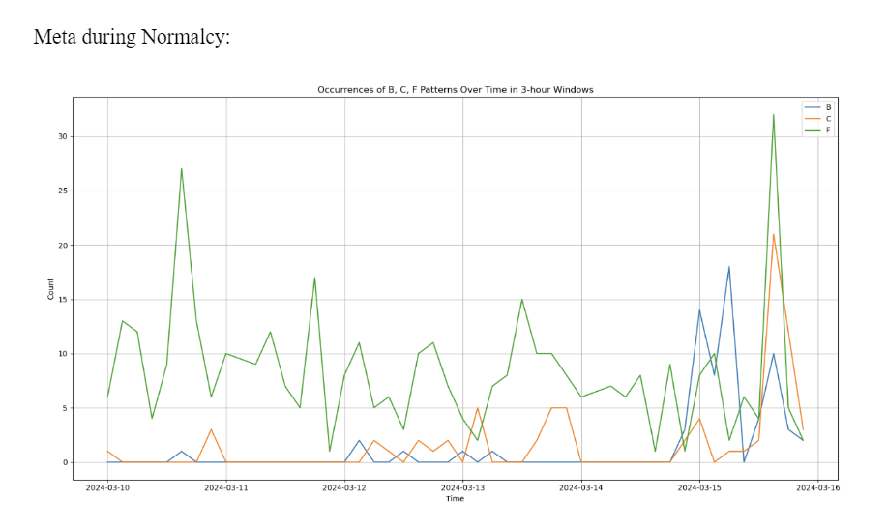
Experimental Results - Meta (Time line B, C, F)

Slide 16
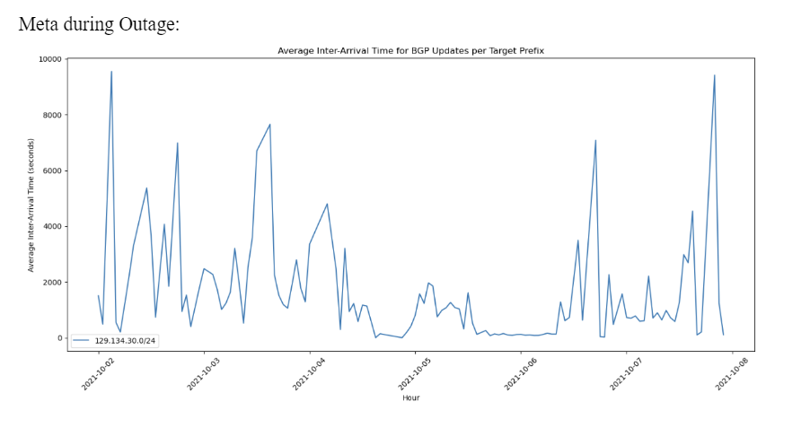
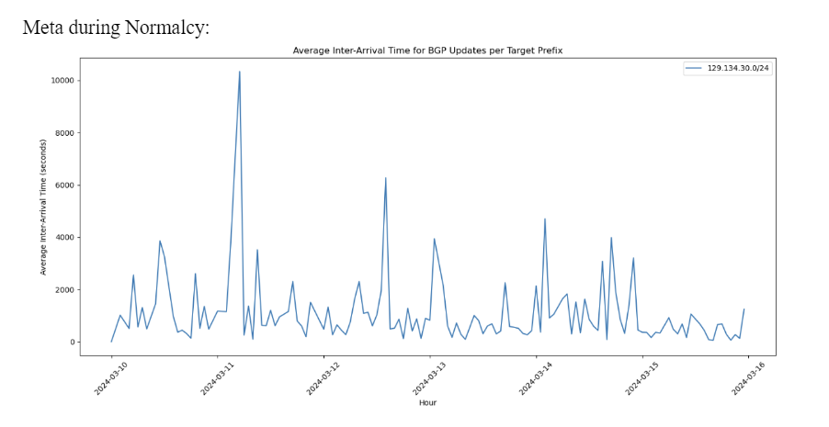
Experimental Results - Meta (Avg Inter-Arrival Time)

Slide 17
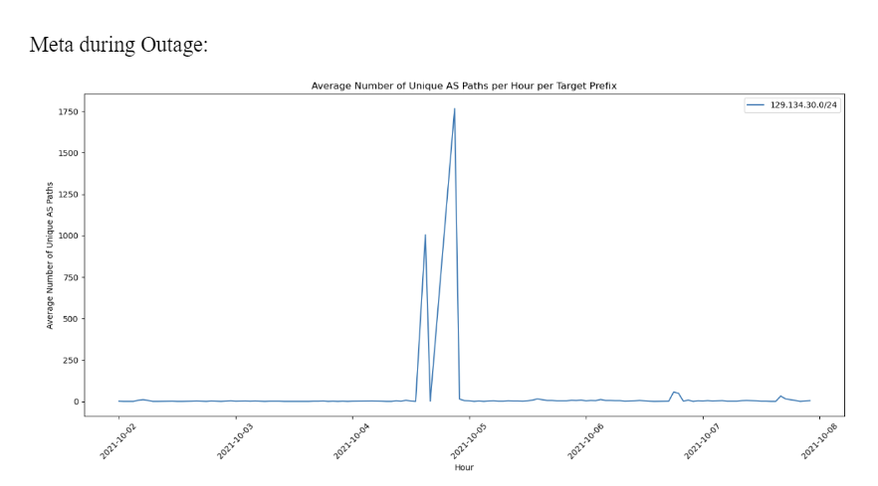
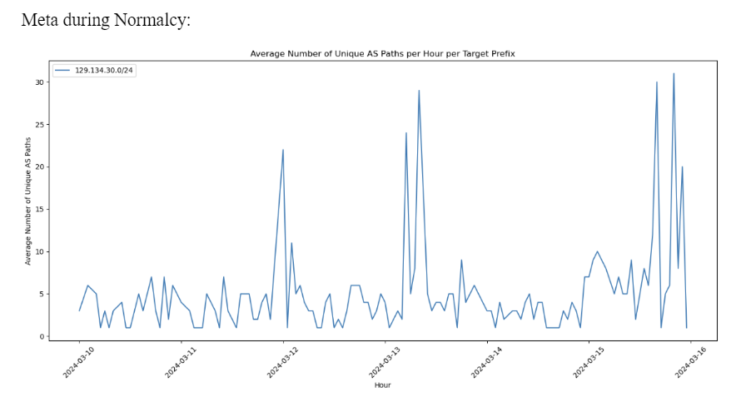
Experimental Results - Meta (Avg Unique AS Paths)

Slide 18
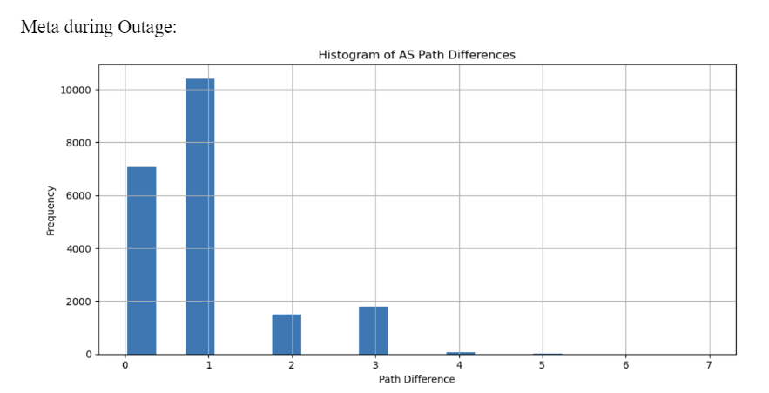
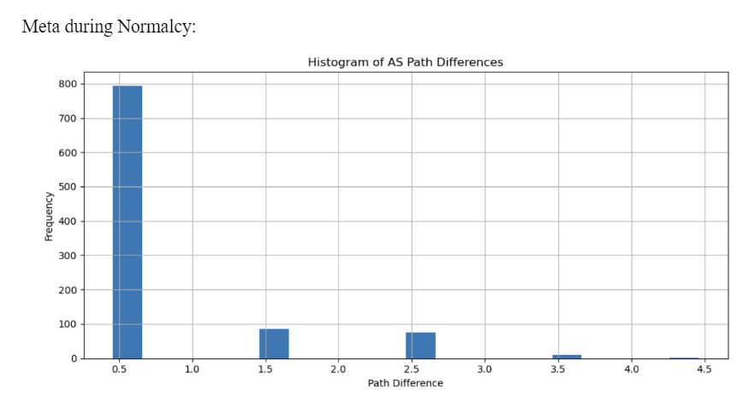
Experimental Results - Meta (AS Path Differences)

Slide 19
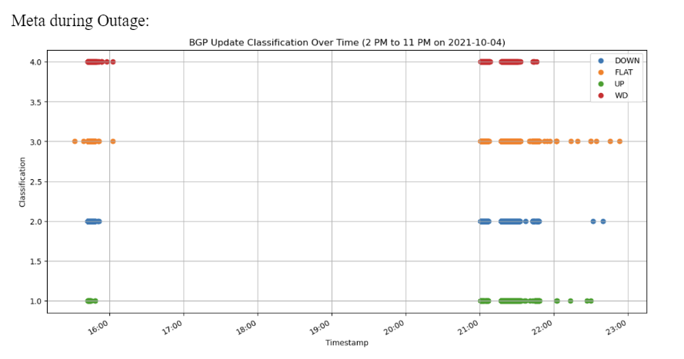
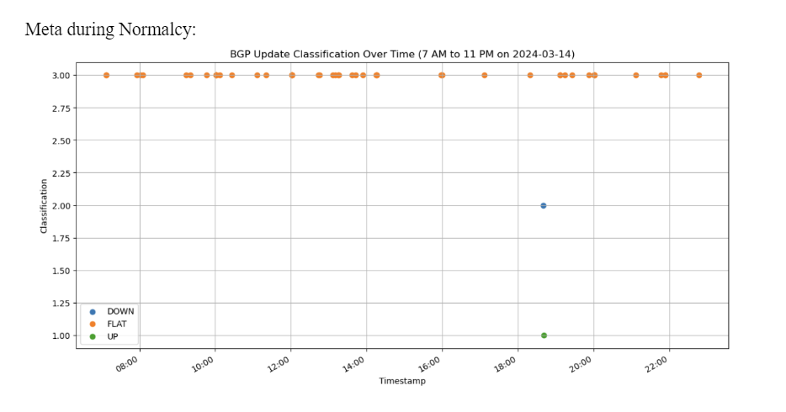
Meta UP, DOWN, FLAT, WD (Outage vs Normal)

Slide 20
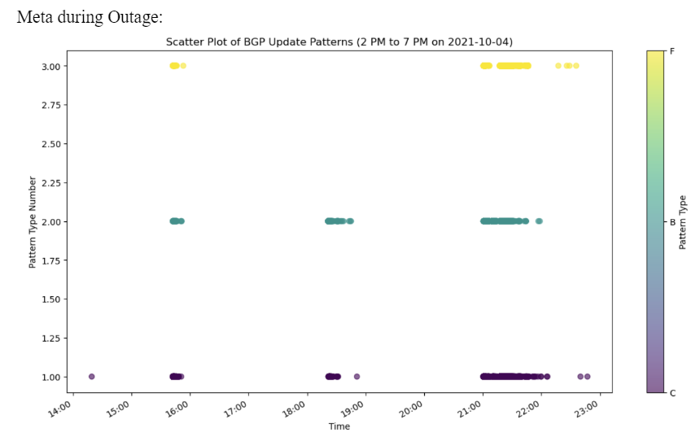
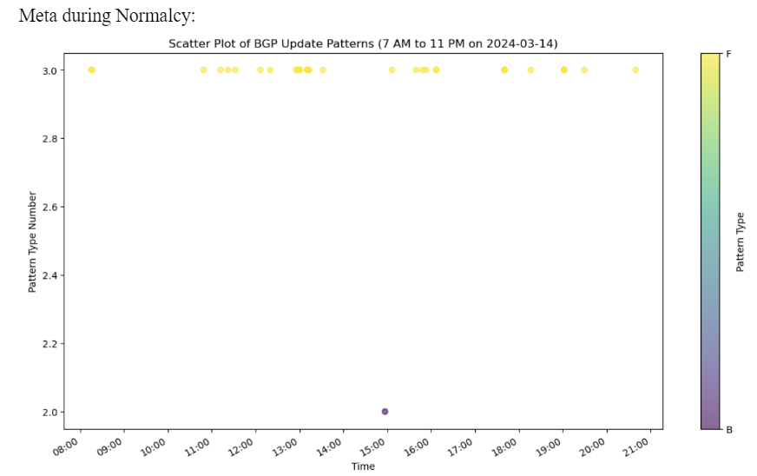
Experimental Results Meta (Outage vs Normal B, C, F)

Slide 21
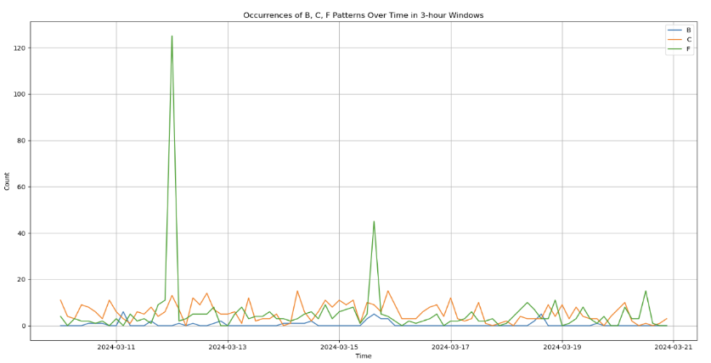
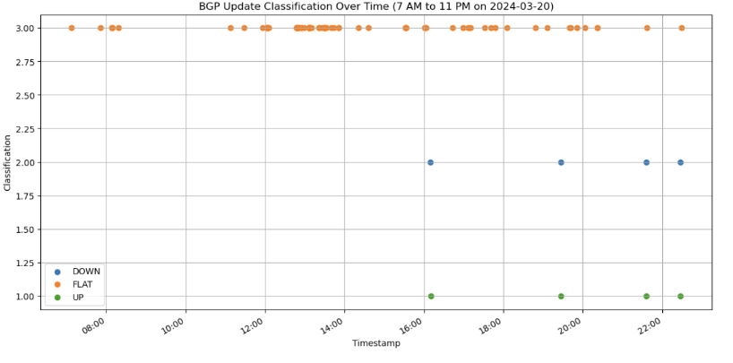
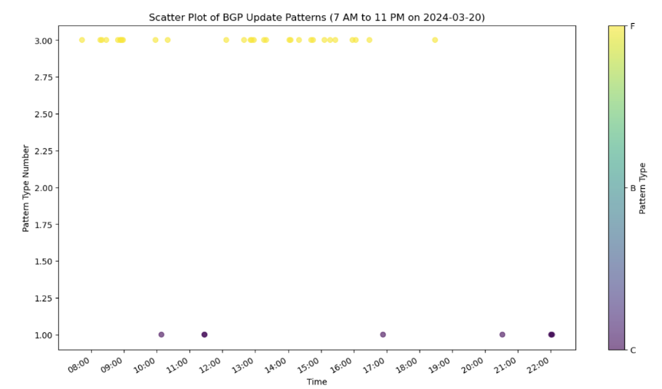
Experimental Results - UCR BGP UPDATES

Slide 22
Conclusion
Conducted long-term analysis of BGP routing dynamics and outlier detection using large datasets.
Implemented dual model system combining signature-based and time/statistics-based methods.
Validated models against real events like 2021 Meta outage, providing visualizations.
Demonstrated accurate detection and classification of BGP routing anomalies.
Bridged theory and practice by incorporating real outage data.
Provides insights for proactive network management and Internet resilience.
Future work: Real-time data, expanded algorithms, potential machine learning integration.
Significant contribution towards secure, stable Internet routing infrastructure.

